Slide 1

Manufacturing a Universal “off the shelf” T cell therapy for treatment of B-Cell lymphomas
Areane Garza

Slide 2
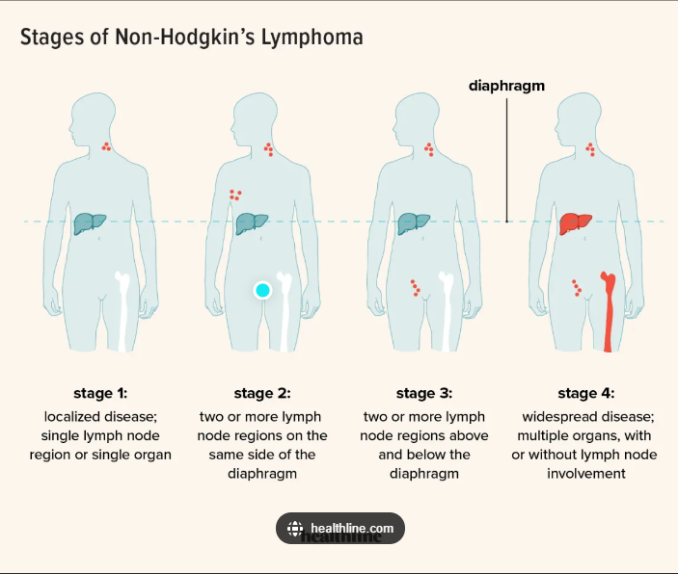
Topic introduction
What is B-cell lymphoma?
Adicet Bio
The Challenges

Slide 3

background
Current solution landscape: While many have shown promise, the question remains how well they match up versus CAR T
- Rituximab: CD20 mAb
- R-CHOP
- High Dose Chemotherapy + Stem cell Transplant
Adicet Bio: clinical stage biotechnology company with the aim to discover & develop allogenic engineered CAR T cell therapies
ADI-001 Mechanism of action: gamma delta T cells rids the body of tumor cells expressing CD20 antigen while sparing healthy cells; shares elements of both innate & adaptive immunity
Has potential to recognize a range of targets & persist in the body for years unlike current therapy options
ADI-001: a treatment developed by Adicet to overcome these challenges for cancers

Slide 4
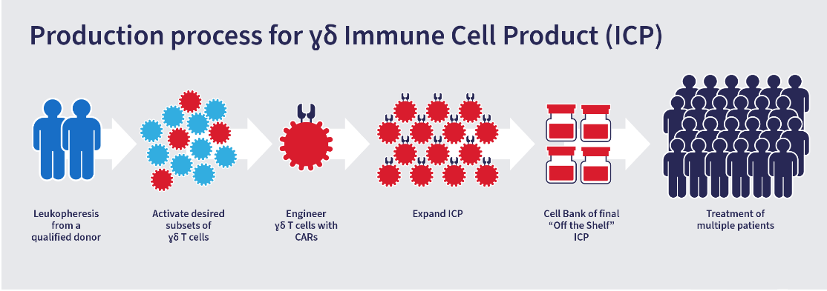
Proprietary cell platform process

Slide 5
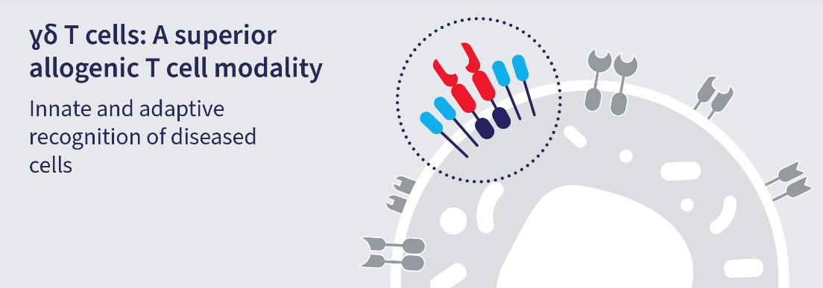
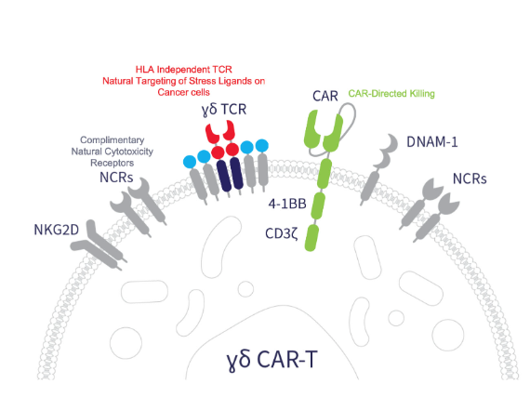
motivation
The Goal: to achieve lasting remission
Car T market outlook as of 2020: both allo and auto; highly valued, driven growth
CAR T considered ‘standard of care’ in many countries

Slide 6
Solution description: ADI-001, Gamma delta CAR T Cells
​Need | Unit of measure | Ideal Value
Feasibility of Production | # of doses/run | ~1000 / production run - enough cells to create a product that can be considered “off the shelf”
Purity | % | > 70%
Efficacy | % | No GvHD(yes/no)
Potency/Cytotoxicity | % | Reduced/no cytotoxic effects on normal B cells :γδ1 CAR T cell
Convenient Administration | < 1 year of treatment regimen | Doses given in outpatient setting (yes/no)

Slide 7
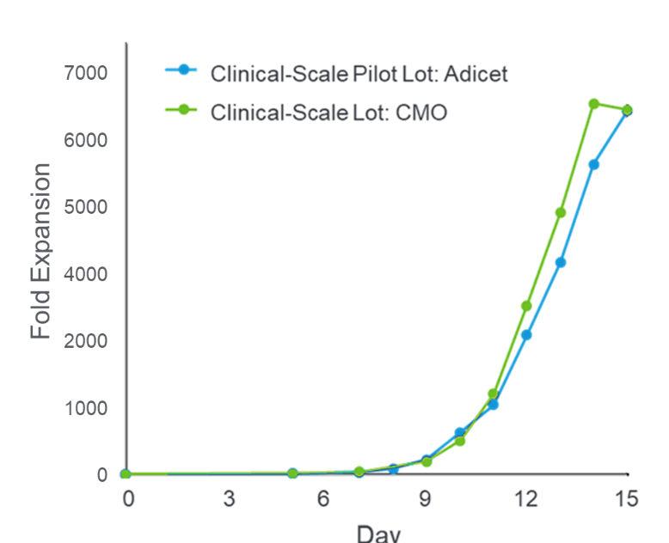
Verification & Validation of ADI-001
Preliminary data from Adicet production runs
Data show cell product can be large-scale manufactured across sites
# of doses manufactured per run ~1000
Enough cells can be manufactured, can be considered “off the shelf”
Potential for Consistent Proprietary Large-Scale Expansion

Slide 8
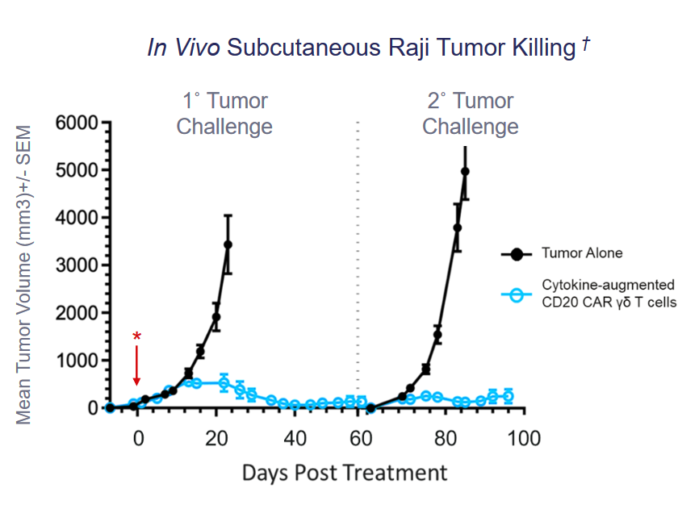
Verification & Validation of ADI-001
ADI-001 Demonstrated CD20-Targeted Activity Against Tumors Post Treatment
Key Takeaways
Anti tumor activity pre-clinically assessed in a mouse model
Low Cytokine-augmented CD20 CAR T cell data mean tumor volumes when challenged with additional Raji cells
ADI-001 showed functional persistence throughout repeat lymphoma challenges, 100 days post treatment

Slide 9
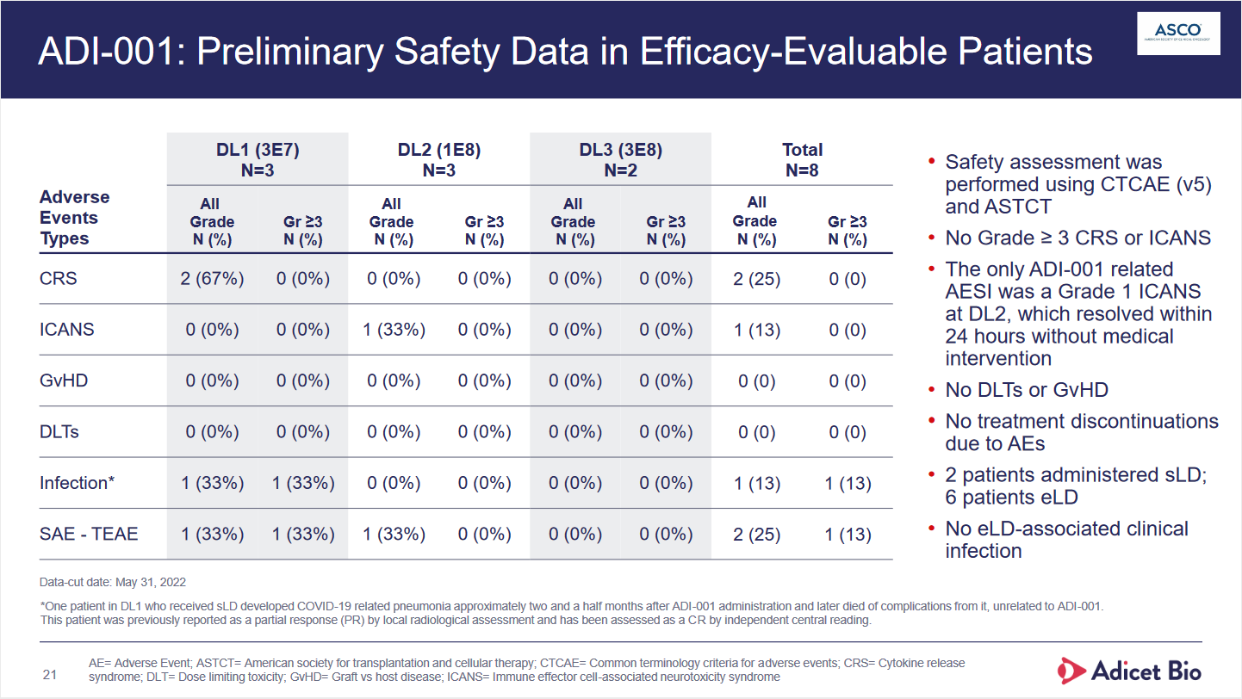
MIRJAM
FLORA BERGGREN
RAJESH SANTOSHI
President
Chief Operations Officer
VP Marketing

Slide 10
conclusion
ADI-001 is a cellularly engineered solution designed to meet the need of lasting remission in adults with relapsed NHL, after attempting multiple modes of treatment
Unique, first of its kind solution, using engineered gamma delta T cells that can be scaled up to provide an off-the-shelf solution for B cell malignancies as the sole mode of treatment

Slide 11
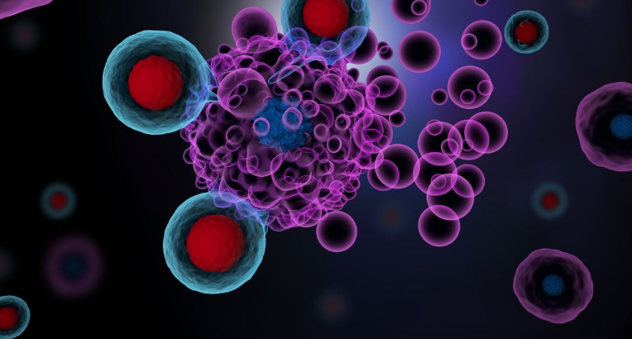
THANK YOU
References
Presentations & Events | Adicet Bio. https://investor.adicetbio.com/events-and-presentations/events/.
“Adicet Data Hints at Early Promise for ‘gamma Delta’ Cell Therapy.” BioPharma Dive, https://www.biopharmadive.com/news/adicet-asco-gamma-delta-lymphoma-results/624515/. Accessed 4 Dec. 2022.
Adicet Bio, Inc. A Phase 1 Safety and Efficacy Study of ADI-001 Anti-CD20 CAR-Engineered Allogeneic Gamma Delta (Γδ) T Cells in Adults With B Cell Malignancies. Clinical trial registration, NCT04735471, clinicaltrials.gov, 19 Oct. 2022. clinicaltrials.gov, https://clinicaltrials.gov/ct2/show/NCT04735471.
“Non-Hodgkin’s Lymphoma - Symptoms and Causes.” Mayo Clinic, https://www.mayoclinic.org/diseases-conditions/non-hodgkins-lymphoma/symptoms-causes/syc-20375680. Accessed 8 Dec. 2022.
Adicet Bio Reports Positive Clinical Update from ADI-001 Phase 1 Trial in Relapsed/Refractory Non-Hodgkin’s Lymphoma (NHL) | Adicet Bio. https://investor.adicetbio.com/news-releases/news-release-details/adicet-bio-reports-positive-clinical-update-adi-001-phase-1/. Accessed 30 Nov. 2022.

